Slide 1


A
Project
by
Dharmesh Bhnaushali
Under the guidance of
Prof. Balaji Venkatraman
Analysis of SDN based ECMP Algorithm for Data Center Networks
Department of Electrical Engineering

Slide 2

INTRODUCTION
Need for Data Center Network
Increased need for data availability and better performance
To Enable large storage domain and faster network switching
What is a Data Center Network
Need for a Scalable network
Need for a Software defined Control
A collection of storage and network devices connected over a communication channel
A Network which provides a virtualized environment
Maximizing flexibility, increasing design life cycle
Decreasing cost of the network and latency
For Dynamic Scheduling of Flows and selecting flows based on bandwidth utilization of core links.
Software Defined Networking
Decoupled control logic from data plane which shifts the control on network to a centralized controller
Decreases the physical management costs and improves operational flexibility

Slide 3
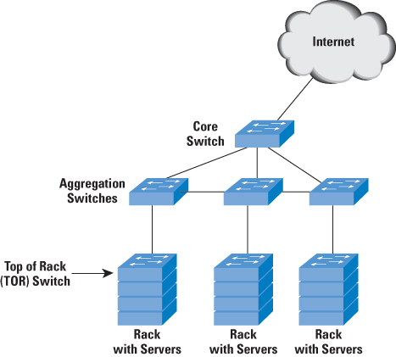
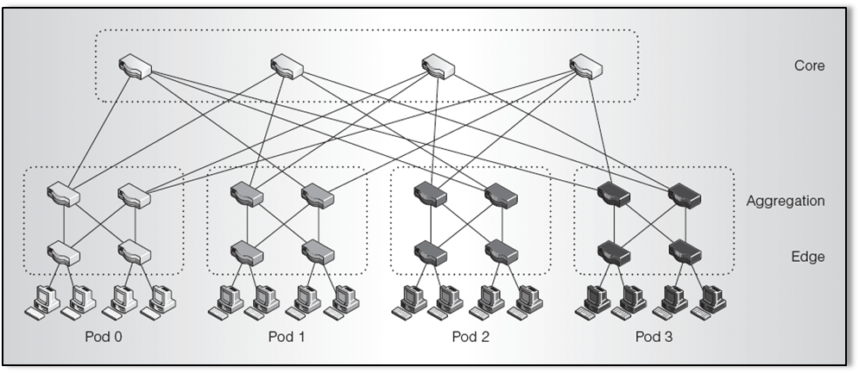
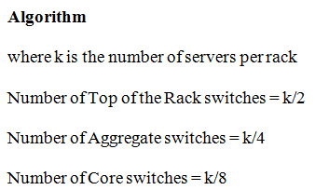
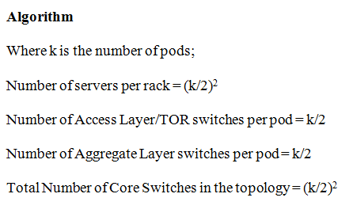
INTRODUCTION
SJSU Washington Square
Multi-Tier Architecture
Fat tree Architecture

Slide 4
Analysis of SDN based ECMP Algorithm for Data Center Networks
KEY COMPONENTS
IPERF- BANDWIDTH CALCULATION
Mininet> iperf <Source Host Name> <Destination Host Name>
*** Iperf: testing TCP bandwidth between <Source Host Name> and <Destination Host Name>
PINGALLFULL-DELAY CALCULATION
Mininet> pingallfull
Mininet- SDN Simulator
POX Controller
STP
ECMP
Ovs-vsctl – Open VSwitch Command Line
Python API

Slide 5
Analysis of SDN based ECMP Algorithm for Data Center Networks
ton Square
FLOW CHART OF TWO EXPERIMENT

Slide 6
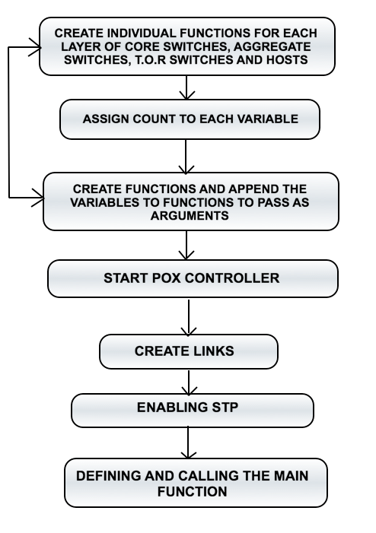
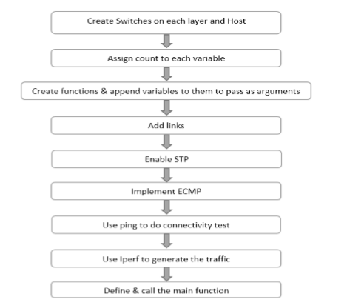
INTRODUCTION: PROGRAM FLOW & TOOLS
PROGRAM FLOW OF FIRST AND SECOND EXPERIMENT

Slide 7
Analysis of SDN based ECMP Algorithm for Data Center Networks
ton Square
Flow chart of SDN based ECMP with central controller

Slide 8
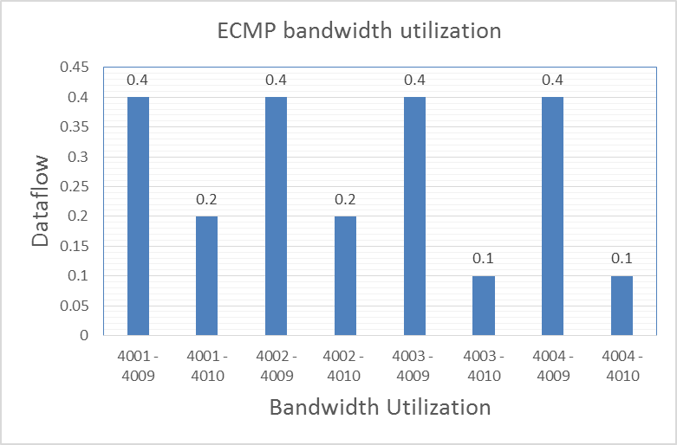
RESULTS
ton Square
Results for ECMP in Fat Tree Topology
DATA | FLOW | Bandwidth Utilization
4001 – 4009 | 4002 – 4009 | 0.4
4001- 4010 | 4002 - 4010 | 0.2
4003 - 4009 | 4004 - 4009 | 0.4
4003 - 4010 | 4004 - 4010 | 0.1

Slide 9
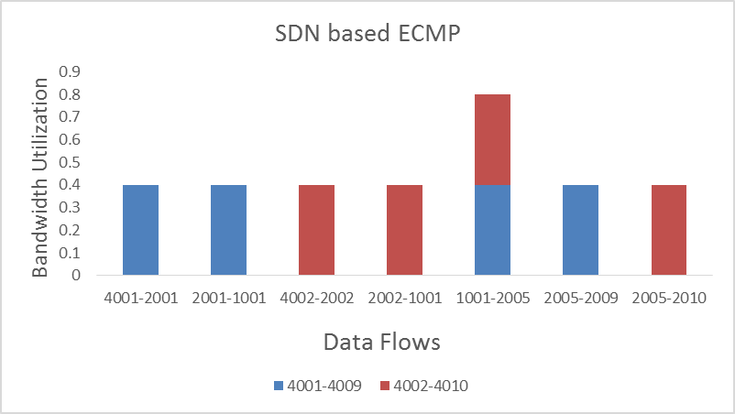
RESULTS
ton Square
Results for SDN based ECMP in Fat Tree topology
DATA | FLOW | Bandwidth Utilization
4001 – 2001 | 4002 – 2002 | 0.4
2001 – 1001 | 2002 - 1001 | 0.4
1001 – 2005 | 1001 – 2005 | 0.4 + 0.4 = 0.8
2005 – 4009 | 2005 - 4010 | 0.4
Pingallfull from Mininet

Slide 10
COMPARATIVE ANALYSIS FOR FAT-TREE AND FAT TREE BASED SDN
ton Square
Comparison of ECMP in Fat Tree Architecture and in SDN based Environment

Slide 11
CONCLUSION
ECMP in Fat Tree Networks
Lack Of flexibility
Lack of Dynamic Scheduling Mechanism
SDN based ECMP in Fat Tree Networks
Offers better Throughput
Central Controller Dynamically adjust flows
Select flows according to links bandwidth utilization .
SDN based environment is suitable for data center networks.

Slide 12
REFERENCES
Software Defined Networks (EWSDN), 2013 Second European Workshop on, Issue Date: 10-11 Oct. 2013, Written by: Teixeira, J.; Antichi, G.; Adami, D.; Del Chiaro, A.; Giordano, S.; Santos, A.
M. Al-Fares, A. Loukissas, and A. Vahdat, ``A scalable, commodity data center network architecture,'' in Proc. ACM SIGCOMM, 2008, pp. 63_74.
Hailong Zhang School of Information Engineering, Communication University of China, Beijing, China Xiao Guo ; Jinyao Yan ; Bo Liu ; Qianjun Shuai - SDN Based ECMP Algorithm for data center networks.
Yi-Chi Lei ,Kuochen Wang and Yi- Huai - Hsu ,Department of Computer Science, National Chiao Tung University, “Multipath Routing in SDN based Datacenter “, 2015

Slide 13



